Slide 1
Git – First Steps
Moritz Flüchter

Slide 2
Content
Creating a repository
Making and saving changes
Notes:
Say, first three steps are very thourough since important to understand everything
Most used commands, basics that are needed
After that, bit more relaxed, information around it

Slide 3
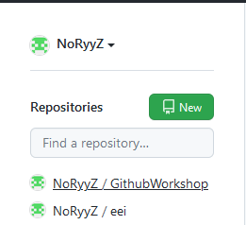
Creating a repository

Slide 4
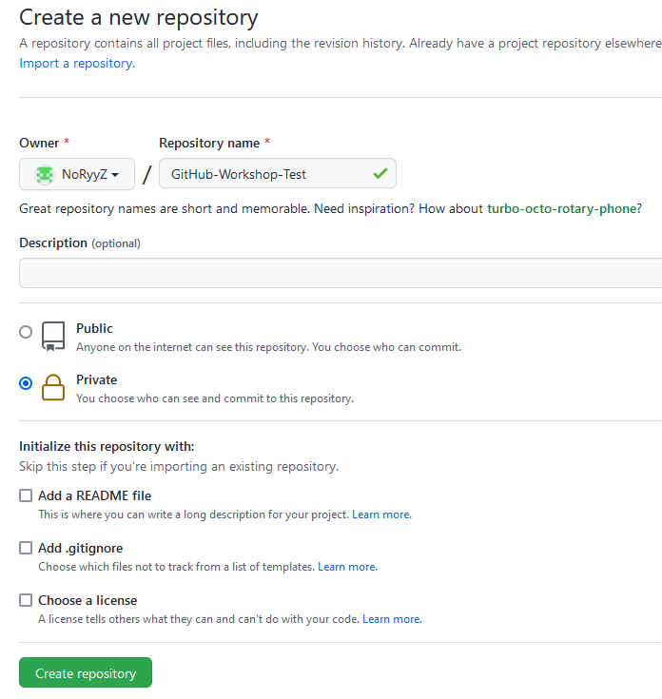
Creating a repository

Slide 5
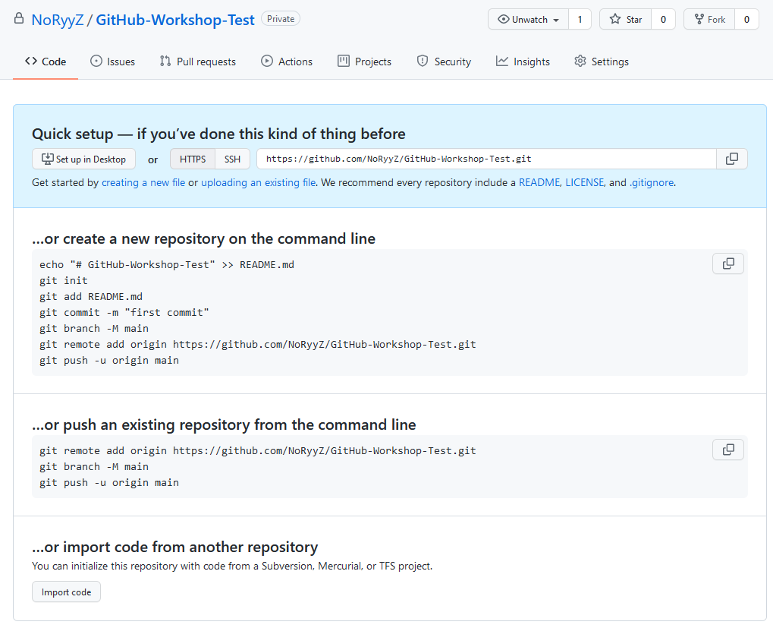
Creating a repository
Common method

Slide 6
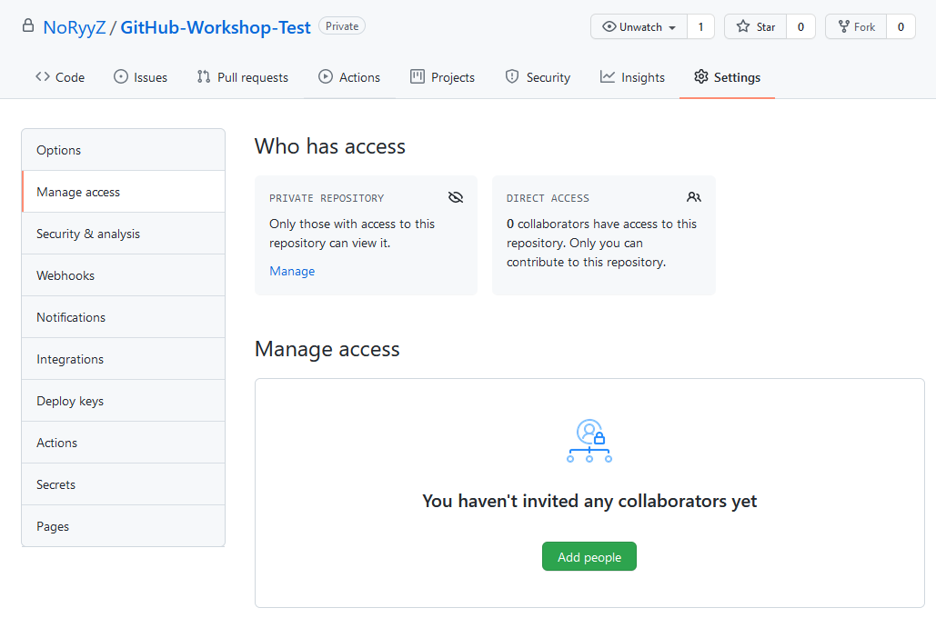
Creating a repository – Adding People
Notes:
Kurz eingeschoben, bevor es vergessen wird

Slide 7
Fetching a repository – git clone
The repository now exists on github.com, but we still need to initialize it loacally via:
$ git clone [remote url]
Notes:
Say, this creates a new sub folder, everything in thuis subfolder will now be tracked

Slide 8
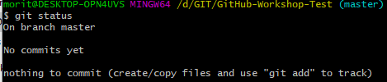
Making and saving changes
You can always check the state of the local repository via:
$ git status

Slide 9
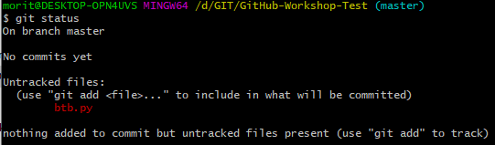
Making and saving changes
Now create any kind of file inside (or copy one into) the repository folder and type git status again:

Slide 10
Making and saving changes
In order to upload the changes to the remote (GitHub), you need to go thorugh 3 steps:
Create a bundle of changes which you want to commit
Commit the bundle of changes with a message
Push the changes to the remote

Slide 11
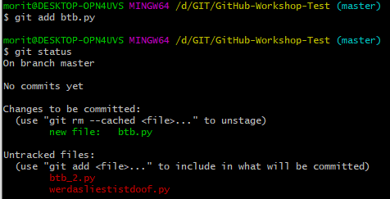
Making and saving changes
Adding changes to the commit bundle via:
$ git add [filename]

Slide 12
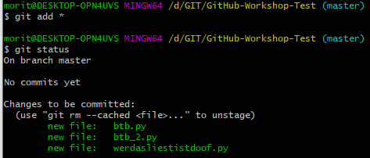
Making and saving changes
Adding all changes to the commit bundle via:
$ git add *

Slide 13
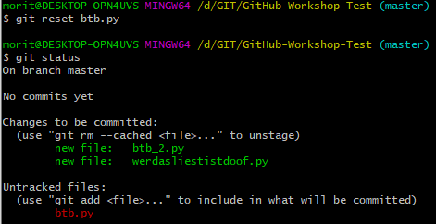
Making and saving changes
Removing changes to the commit bundle via:
$ git reset [filename]

Slide 14

Making and saving changes
After adding all files, create the commit via:
$ git commit –m „[message]“
(You can leave out –m [message], but then Git will use another way to force you to enter a message!)
Notes:
Say, this creates a new sub folder, everything in thuis subfolder will now be tracked

Slide 15
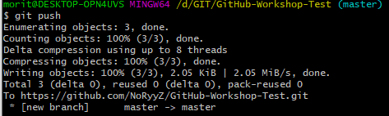
Making and saving changes
After commiting, we can push the changes to the remote via:
$ git push
(You can also first create multiple commits and then push them!)
Notes:
Say, this creates a new sub folder, everything in thuis subfolder will now be tracked

Slide 16
Making and saving changes - Collaborating
Before making changes, the first step should always be to check github for updates if youre collaborating with other people.
$ git pull
Important: Git does not automatically check for changes on the remote (GitHub)!
Notes:
Say, this creates a new sub folder, everything in thuis subfolder will now be tracked

